Slide 1

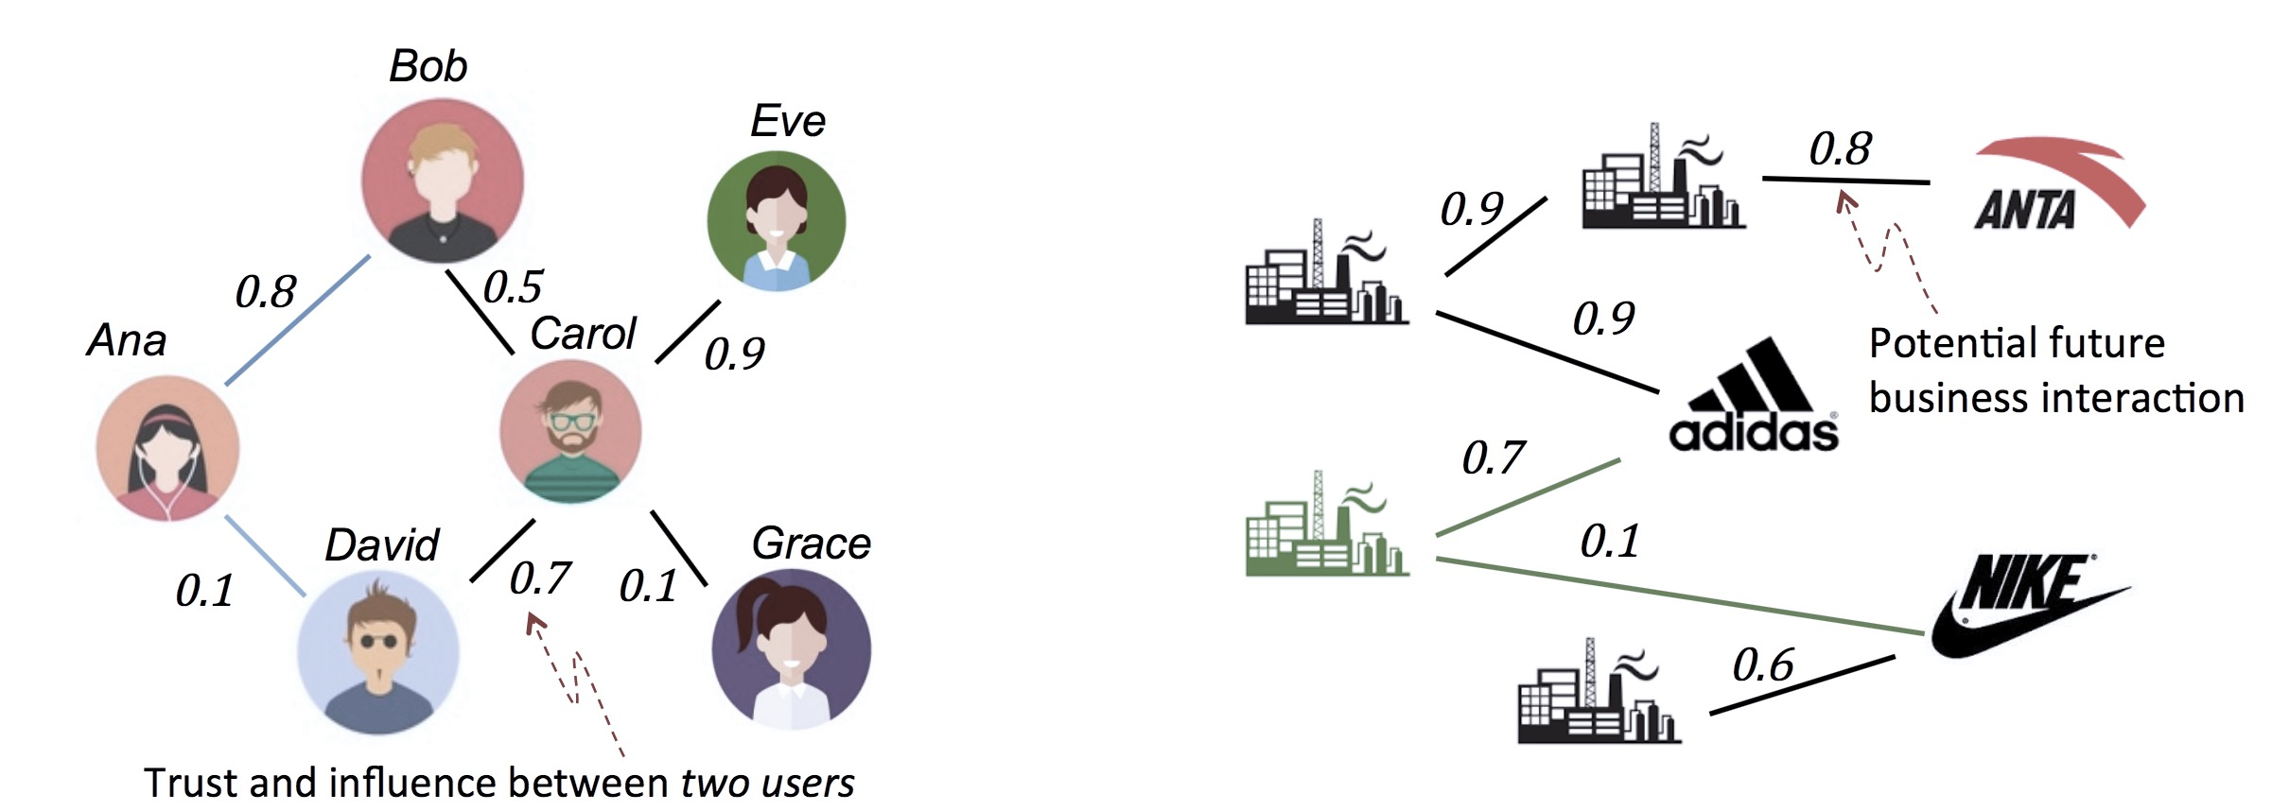
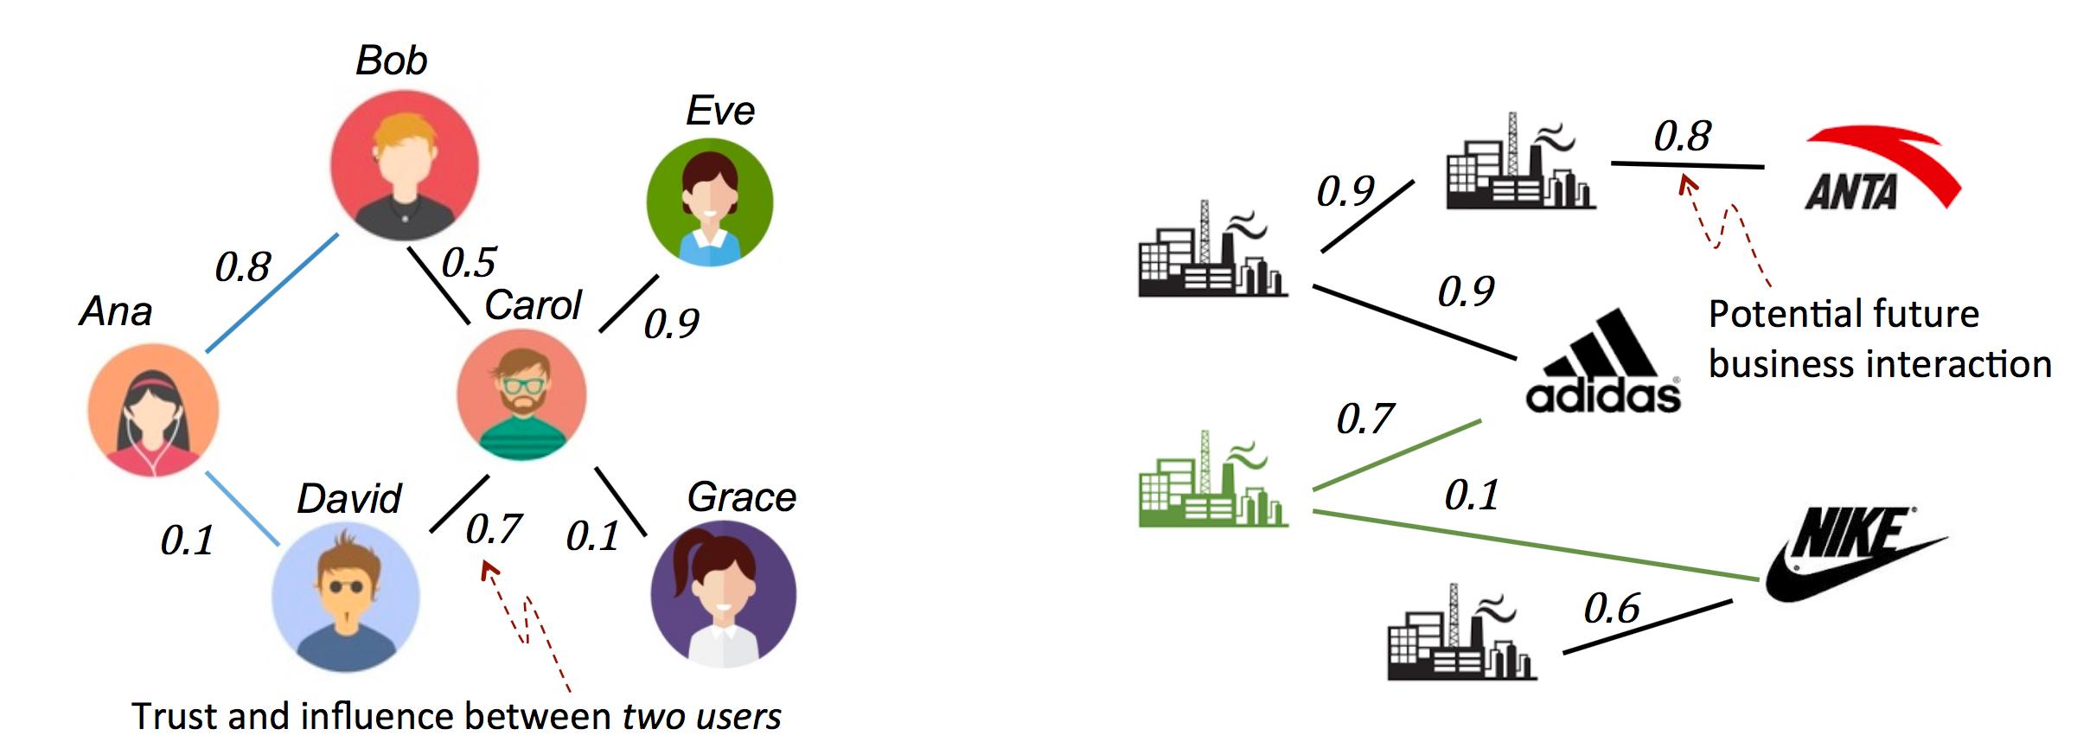

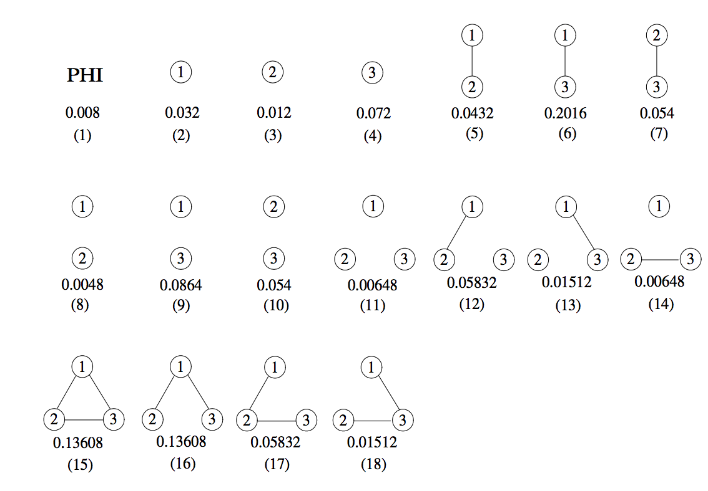
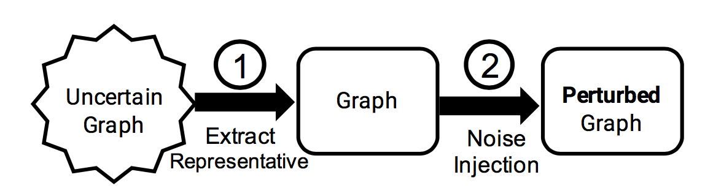

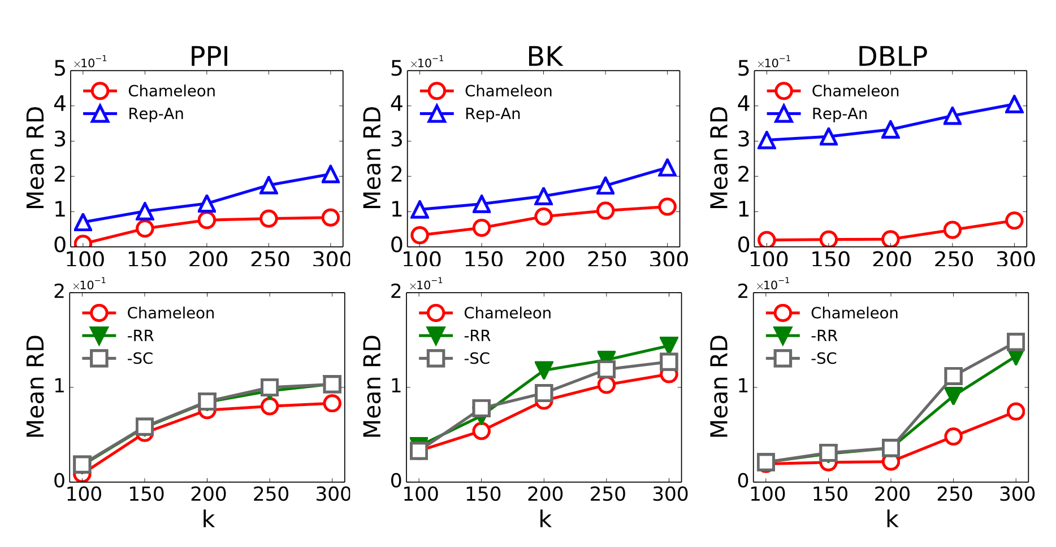
Sharing Uncertain Graphs Using Syntactic
Private Graph Model
Dongqing Xiao, Mohamed Eltabakh, Xiangnan Kong
Worcester Polytechnic Institute, USA
dxiao, meltabakh,xkong@wpi.edu
Objective: Sharing Uncertain Graphs
Challenges
Stochastic Privacy Attack
Stochastic Utility Loss
Intractable Search Space
Leak caused by edge uncertainty
Structural difference over uncertain graphs
Exponential
search space
Data
Chameleon: Uncertain Graph Anonymization Solution
Concern: Privacy Breach
Baseline Approach: Rep-An
Combines isolated techniques
Suffers from huge utility loss
With the possible world semantics
Enables a fine- grained control of injected noise
max
1.
Heuristic Evaluation
Utility Relevance (RR)
Data
Guided Random Search
2.
Random
Sampling
Privacy Vulnerability (SC)
Option: Anonymization
mid
min
3.
Selection
(k-anonymity variant)
Binary search
the minimal amount of necessary noise
Uncertain Graph
Empirical Evaluation
Weighted Graph
@ possible world semantic
Rep-An: Baseline Approach
SC: Stochastic Controlled Heuristic
RR: Reliability Relevance Heuristic
The simplest case: edge independent
Current graph anonymization techniques only target deterministic graphs and overlook the uncertain scenario.
The generated anonymized uncertain graphs
that closely match the original ones w.r.t Reliability .

